Slide 1
Sui Course 2023 / Part 2-3

Slide 2
Object Wrapping and Unwrapping

Slide 3
Agenda
Overview of Object Wrapping
Object Wrapping
Object Unwrapping
Security Considerations
Exercise

Slide 4
Overview of Object Wrapping

Slide 5

What is Object Wrapping?
Object Wrapping in the context of the Move programming language, often used in blockchain technology, is a pattern used for enhancing the security , integrity of objects and promotes data composability.
Notes:
"Object Wrapping" in the context of the Move programming language, often used in blockchain technology, is a pattern used for enhancing the security, integrity, and data composability of objects.
By utilizing the concept of object wrapping, developers can encapsulate and protect the internal state of objects, preventing unauthorized access and modification. This pattern helps maintain the integrity of the object's data, ensuring that it remains consistent and valid throughout its lifecycle.
Moreover, object wrapping in Move also facilitates data composability, allowing objects to be composed and combined in a modular and flexible manner. This composability feature enables developers to create complex data structures and systems by assembling and reusing existing objects, enhancing code reusability and scalability in blockchain applications.
In summary, object wrapping in Move not only enhances security and integrity but also promotes data composability, enabling developers to build robust and flexible blockchain systems.

Slide 6
Why do we use Object Wrapping?
Encapsulation This reduces the complexity of the system and improves modularity. | Access Control It allows controlled access to the properties of the object.
Security The properties of the object can be manipulated only in the ways defined by the object's methods. | Maintenance and Upgradation Object Wrapping makes it easier to upgrade or modify the system without affecting other parts of the system.
Object Wrapping
Notes:
Object Wrapping is used in Sui Move for several reasons:
Encapsulation: Object Wrapping helps encapsulate or hide the properties and implementation details of an object from other objects. It only exposes the methods and properties that are necessary. This reduces the complexity of the system and improves modularity.
Access Control: It allows controlled access to the properties of the object. Only the methods and properties that are exposed can be accessed, providing an interface to interact with the object while keeping the details private.
Security: By encapsulating the object, it provides a layer of security. The properties of the object can be manipulated only in the ways defined by the object's methods. This ensures that the object remains in a valid state and cannot be tampered with unexpectedly.
Maintenance and Upgradation: Object Wrapping makes it easier to upgrade or modify the system without affecting other parts of the system. As long as the interface remains the same, changes to the implementation of the object will not affect the rest of the system.
In Sui Move, Object Wrapping is particularly crucial due to the immutable and secure nature of the blockchain. It is essential to ensure that the state and properties of an object can be controlled and manipulated only in specified ways, maintaining the integrity and security of the blockchain.

Slide 7


How does it work in Sui Move?
Wrapper
Put inside object
Accessing object through interface
Authorized user
Notes:
In Sui Move, when we wrap an object, it gets put inside another object, called the 'wrapper'. The wrapper provides an external interface and controls who can access our original object.

Slide 8
Object Wrapping

Slide 9
Three Methods of Sui Object Wrapping
Object Wrapping
Direct wrapping
Wrapping through Option
Wrapping through vector
Notes:
Sui Object Wrapping encompasses three distinct methods: Direct Wrapping, Wrapping through Option, and Wrapping through Vector. Let's explore each of these methods:
Direct Wrapping: This method involves putting a Sui object type directly as a field in another Sui object type. The wrapped object cannot be unwrapped unless we destroy the wrapping object.
Wrapping through Option: Wrapping through Option is a method that provides flexibility in object wrapping by allowing the wrapped object to be optional within the wrapping type. In this approach, the wrapping type may or may not contain the wrapped object, and the wrapped object can be replaced with a different object if desired.
Wrapping through vector
:Wrapping through vector is a concept where objects are wrapped within a vector field of another Sui object. This approach allows for the inclusion of zero, one, or multiple wrapped objects of the same type within the vector field.

Slide 10
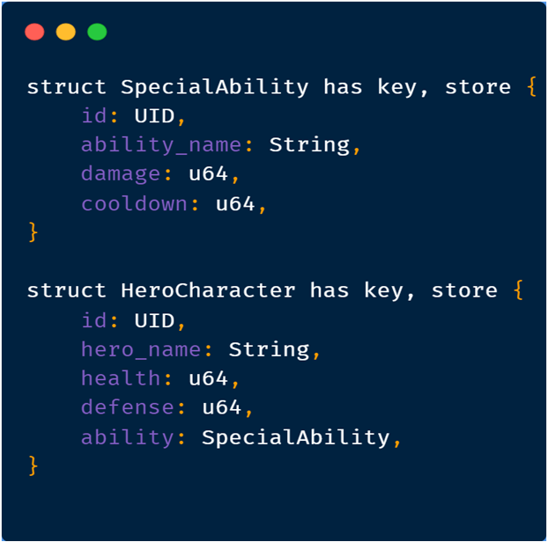
Direct wrapping
Define Struct:
HeroCharacter wraps the SpecialAbility object
Notes:
This code defines two structs: SpecialAbility and HeroCharacter.
The SpecialAbility struct represents a special ability and has the following fields:
○id: UID, which is used to identify the unique ID of the special ability.
○ability_name: String, representing the name of the special ability.
○damage: u64, indicating the damage value of the special ability.
○cooldown: u64, representing the cooldown time of the special ability.
The HeroCharacter struct represents a hero character and includes the following fields:
○id: UID, used to identify the unique ID of the hero character.
○hero_name: String, indicating the name of the hero character.
○health: u64, representing the health value of the hero character.
○defense: u64, indicating the defense value of the hero character.
○ability: SpecialAbility, representing the special ability of the hero character. This field contains an object of type SpecialAbility, describing the special ability of the hero.
These structures define the properties and relationships between special abilities and hero characters. The SpecialAbility struct encapsulates the details of a specific ability, while the HeroCharacter struct represents a hero with its associated attributes, including their special ability.

Slide 11
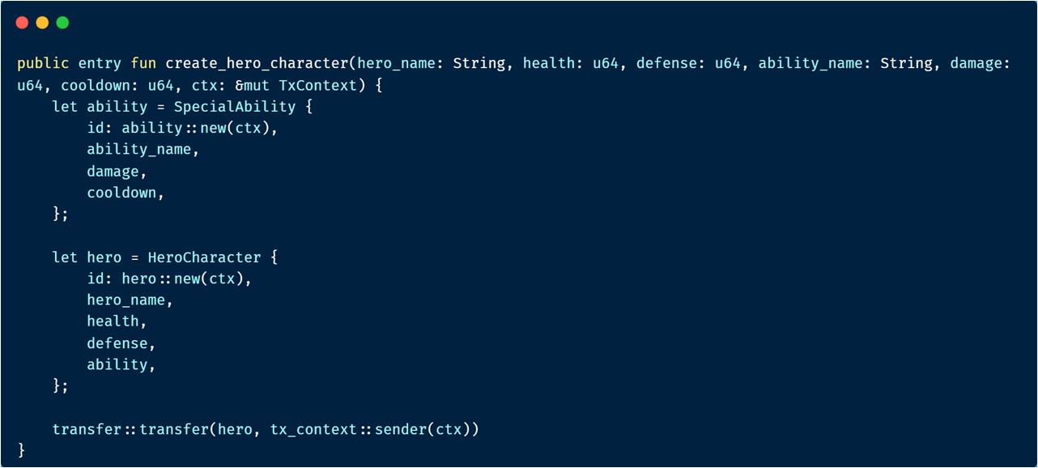
Direct wrapping
Wrap a object:
Notes:
The unique feature of direct wrapping here is that the "Special Ability" cannot be changed or "unwrapped" from the "Hero Character" unless the "Hero Character" itself is destroyed or replaced.
Creating a new "Hero Character" with a "Special Ability" could be done as follows:
In this function, a new "Special Ability" is created and directly wrapped within the new "Hero Character". The newly created "Hero Character" is then transferred to the player initiating the transaction.

Slide 12
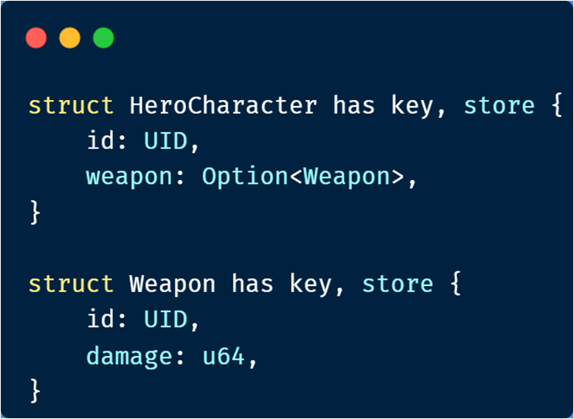
Wrapping through Option
Notes:
In this example, the HeroCharacter struct directly contains an Option of the Weapon struct, which means that the HeroCharacter may or may not have a weapon.
It's important to note that when an object is wrapped, it no longer exists independently on-chain. We can no longer look up this object by its ID. This object becomes part of the data of the object that wraps it. At some point, we can take out the wrapped object and transfer it to an address. This process is called unwrapping. When an object is unwrapped, it will become an independent object again, and can be accessed directly on-chain. The object's ID stays the same across wrapping and unwrapping​​.

Slide 13
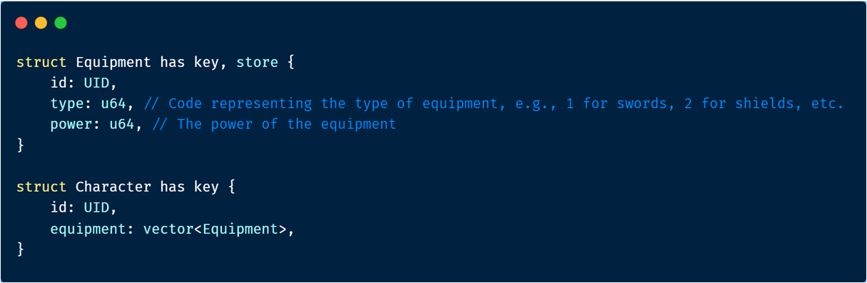
Wrapping through vector
Notes:
In this example, we have defined Equipment and Character structs. The Character has an equipment field, which is a vector of Equipment. This signifies that the character can carry multiple pieces of equipment.

Slide 14
Object Unwrapping

Slide 15
What is Object Unwrapping?
Unwrapping refers to the process of extracting the encapsulated object.
Notes:
In the Sui move programming model, the concept of "wrapping" and "unwrapping" is essential. Wrapping refers to the process of encapsulating one object within another, while unwrapping refers to the process of extracting the encapsulated object.
When an object is wrapped, it no longer exists independently on-chain, and we can no longer look it up by its ID. The object becomes part of the data of the object that wraps it, and can no longer be passed as an argument in Move calls. The only access point is through the wrapping object.
Unwrapping, on the other hand, refers to the process of taking out the wrapped object and transferring it to an address. This is generally done in the middle of a Move execution and cannot be persisted on-chain. This is because a non-Sui object cannot flow across the Move-Sui boundary, and one must unpack the non-Sui object at some point and deal with the Sui object fields in it.
In the case of unwrapping, one common method is to call the unwrap function, which takes an object and its address as arguments and returns the object at that address, effectively unwrapping it. If an error occurs during this process, the Sui VM will raise an exception and abort the transaction executing these bytecode.

Slide 16
How to unwrap?
In the case of unwrapping, one common method is to call the unwrap function, which takes an object and its address as arguments and returns the object at that address, effectively unwrapping it
Notes:
In the case of unwrapping, one common method is to call the unwrap function, which takes an object and its address as arguments and returns the object at that address, effectively unwrapping it. If an error occurs during this process, the Sui VM will raise an exception and abort the transaction executing these bytecode.

Slide 17
Gaming Example: LootBox and Treasure
In this game, players can find loot boxes that contain treasures. These loot boxes can be unwrapped by a specific player.
Notes:
In this game, players can find loot boxes that contain treasures. These loot boxes can be opened by a specific player.

Slide 18
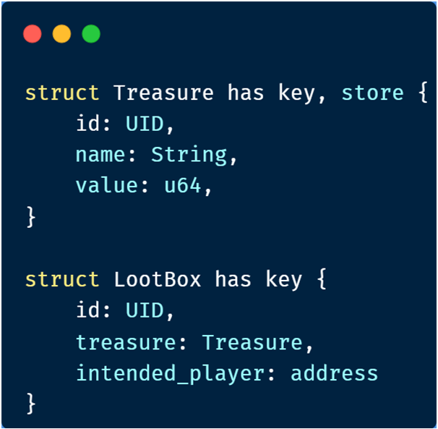
LootBox and Treasure Structs
Represents a treasure with id, name, and value fields
Represents a loot box with id, treasure, and intended_player fields.
Notes:
This code defines two related data structures. The Treasure struct represents a treasure, containing its unique identifier, name, and value. The LootBox struct represents a loot box, containing its unique identifier, treasure, and the intended player for the loot box.

Slide 19
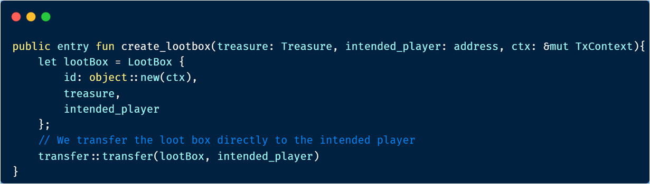
Creating a LootBox
Notes:
This piece of code defines a public entry function called create_lootbox that takes three parameters: treasure of type Treasure, intended_player of type address, and ctx of type &mut TxContext.
Inside the function, a new instance of the LootBox struct is created and assigned to the variable lootBox. The id field of the LootBox struct is initialized with the result of the object::new(ctx) function call. The treasure field is assigned the value of the treasure parameter passed to the function, and the intended_player field is assigned the value of the intended_player parameter.
After creating the lootBox, the code performs a transfer of the loot box directly to the intended player using the transfer::transfer function. The lootBox variable and the intended_player variable are passed as arguments to the transfer function.

Slide 20
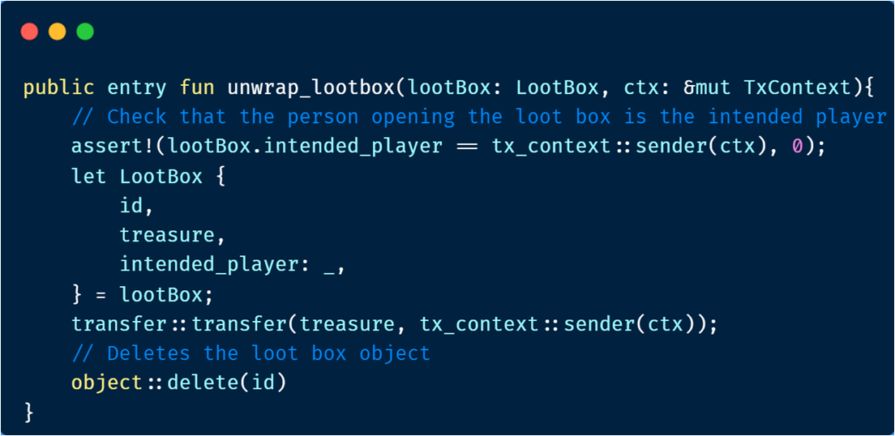
Unwrapping a LootBox
Notes:
This code defines a public entry function called unwrap_lootbox that takes two parameters: lootBox of type LootBox and ctx of type &mut TxContext.
Within the function, the code first checks if the person opening the loot box is the intended player by using the assert! macro. It compares the lootBox.intended_player field with the sender of the transaction (tx_context::sender(ctx)). If they are not equal, the assertion fails and the execution is halted.
Next, the code performs a destructuring assignment on the lootBox variable, extracting the id, treasure, and intended_player fields. However, since the intended_player field is not used in the subsequent code, it is assigned to the placeholder _.
After the destructuring assignment, the code transfers the treasure from the loot box to the sender of the transaction using the transfer::transfer function. The treasure and tx_context::sender(ctx) are passed as arguments to the function.
Finally, the code deletes the loot box object using the object::delete function, passing the id as the argument.

Slide 21
Security Considerations

Slide 22



Security Considerations
Access Control
Privacy
Auditability
Integrity
Error Handling
Notes:
Access Control: Only authorized parties should be able to initiate a swap, access, or unwrap objects. This can be ensured through permission checks in the implementation.
Privacy: The wrapped objects should be kept private, i.e., the service provider should not be able to access or steal the underlying objects. To ensure this, objects can be encrypted before being wrapped.
Integrity: The integrity of the objects during the swapping process must be maintained. This means that the objects should not be altered during the swap process. This can be ensured through cryptographic checks.
Auditability: All actions should be auditable. This means that there should be a clear record of all object wrapping and swapping activities, including who performed the action and when it was performed.
Error Handling: Proper error handling mechanisms should be in place to manage and mitigate any issues that arise during the object wrapping and swapping process.

Slide 23
Exercise
Notes:
Finally, we will do a Sui Move exercise to consolidate our knowledge. This exercise will involve struct definition, ability usage, function implementation, and return values, etc.

Slide 24
Try to complete the card game module.
The core of the card game module has:
Creating Card and Player objects
Implementing card drawing logic
Implementing card swapping logic
Checkout： Exercise Doc
Exercise

